Slide 1

Computer Hardware Throughout the years
Samir,Quinten,Braylen

Slide 2
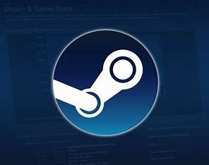
Introduction
Steam is a massive online storefront for computer games. Every month, users get the option to opt-in to a hardware survey for the world to see how computer hardware is changing.

Slide 4
Video Cards
AMD? NVIDIA? Or maybe even Intel? This debate has been a thing since the beginning of computer gaming. As we can see by this graph created from the steam hardware data,
Nvidia has always dominated the Video Card market.
WITH months AS (
SELECT date,
SUM(CASE WHEN (name LIKE "%AMD%" OR name LIKE "%ATI%") THEN percentage END) AS AMD,
SUM(CASE WHEN (name LIKE "%NVIDIA%") THEN percentage END) AS NVIDIA,
SUM(CASE WHEN (name LIKE "%Intel%") THEN percentage END) AS Intel,
FROM `neat-library-412602.shs.HardwareSurvey`
WHERE category = "Video Card Description (Windows)" OR category = "Video Card Description (PC)"
GROUP BY date
)
SELECT
EXTRACT(YEAR FROM date) AS Year,
AVG(AMD) AS AMD, AVG(NVIDIA) AS NVIDIA, AVG(Intel) AS Intel
FROM months
GROUP BY Year

Slide 5
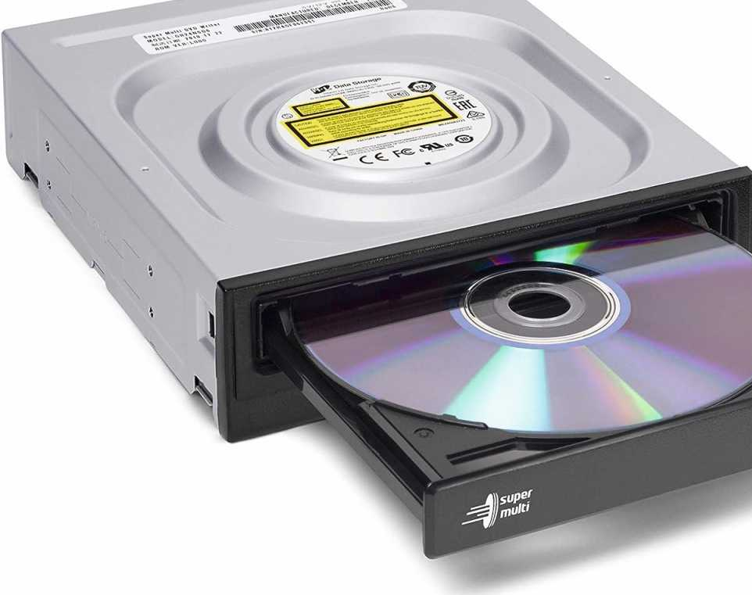
The decline of Optical Drives
Remember Optical Drives? Many computers in offices and even in this classroom still have them. Over time, manufacturers have stopped including them in computers due to them becoming obsolete to better and more modern technology such as USB thumb drives.

Slide 7
The Push of Windows 10
On July 29 2015 Microsoft released their new Windows 10 operating system. With these bar graphs we can see how fast users switched over to Windows 10 and taking over Windows 7.

Slide 8
Task
Need two different visualization

